Slide 1
Advanced Analytics Bootcamp
Module 3: Regression Techniques Learning & Development

Slide 2
Over the next 1.5 hours you will learn about…
Linear Regression
Linear Regression with Multiple Variables
Outliers & Influential Points
Outlier Leverage
Logistic Regression
How to Evaluate Linear & Logistic Regression Models

Slide 3
Linear Regression

Slide 4
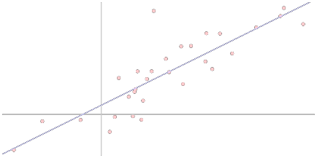
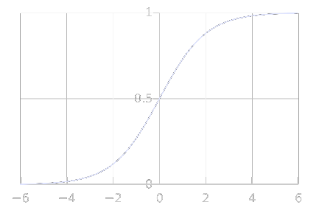
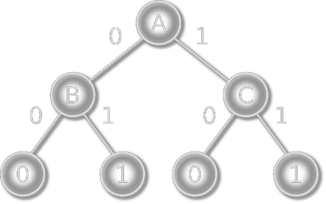
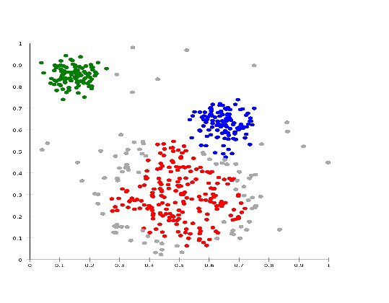
Mathematical and Statistical Ways for Machine Learning Linear Regression
Decision Trees
Logistic Regression
Clustering
Notes:
naive Bayes classifier is an algorithm that uses Bayes' theorem to classify objects. Naive Bayes classifiers assume strong, or naive, independence between attributes of data points. Popular uses of naive Bayes classifiers include spam filters, text analysis and medical diagnosis. These classifiers are widely used for machine learning because they are simple to implement.
Naive Bayes is also known as simple Bayes or independence Bayes.
A naive Bayes classifier uses probability theory to classify data. Naive Bayes classifier algorithms make use of Bayes' theorem. The key insight of Bayes' theorem is that the probability of an event can be adjusted as new data is introduced.
What makes a naive Bayes classifier naive is its assumption that all attributes of a data point under consideration are independent of each other. A classifier sorting fruits into apples and oranges would know that apples are red, round and are a certain size, but would not assume all these things at once. Oranges are round too, after all.
A naive Bayes classifier is not a single algorithm, but a family of machine learning algorithms that make uses of statistical independence. These algorithms are relatively easy to write and run more efficiently than more complex Bayes algorithms.
The most popular application is spam filters. A spam filter looks at email messages for certain key words and puts them in a spam folder if they match.
Despite the name, the more data it gets, the more accurate a naive Bayes classifier becomes, such as from a user flagging email messages in an inbox for spam.
Naive bayes does quite well when the training data doesn't contain all possibilities so it can be very good with low amounts of data. Decision trees work better with lots of data compared to Naive Bayes.
Naive Bayes is used a lot in robotics and computer vision, and does quite well with those tasks. Decision trees perform very poorly in those situations.

Slide 5
Linear Regression
HOUSING PRICES
Price (in 1000s of dollars)
500
400
300
200
100
0
0
500
1000
1500
2000
2500
3000
Size (feet²)

Slide 6
Linear Regression
Supervised Learning
Given the “right answer” for each example in the data
Regression Problem
Predict real/ continuous valued output

Slide 7
Training Set of Housing Prices
Size in feet² (x) | Price ($) in 1000's (y)
2104 | 460
1416 | 232
1534 | 315
852 | 178
… | …
Notation:
m = Number of training examples, m= 4
X’s = “Input” variable/ features
Y’s = “output” variable/ “target” variable
(x, y) is a training example
1

Slide 8

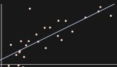
Training Set of Housing Prices
Training Set
How do we represent h ?
Learning Algorithm
y
Size of House
x
h
Estimated Price
x
Linear regression with one variable (x)
Univariate linear regression
Hypothesis
Notes:
Linear regression attempts to model the relationship between two variables by fitting a linear equation to observed data. One variable is considered to be an explanatory variable, and the other is considered to be a dependent variable
A linear regression line has an equation of the form Y = a + bX, where X is the explanatory variable and Y is the dependent variable. The slope of the line is b, and a is the intercept (the value of y when x = 0).

Slide 9



Linear Regression with One Variable: Cost Function
How to choose
Size in feet² (x) | Price ($) in 1000's (y)
2104 | 460
1416 | 232
1534 | 315
852 | 178
… | …
Training Set
Hypothesis:
‘s: Parameters
‘s ?

Slide 10

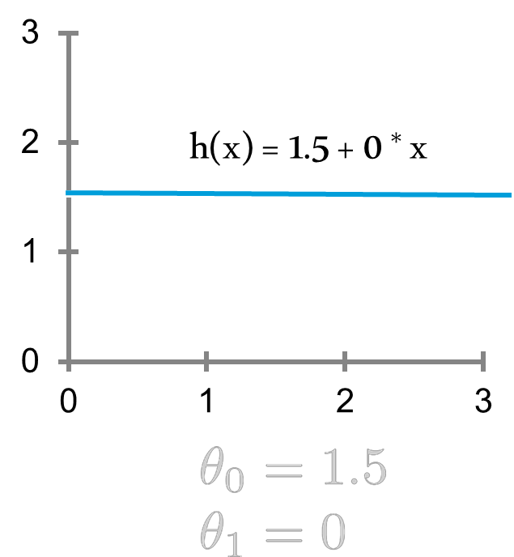
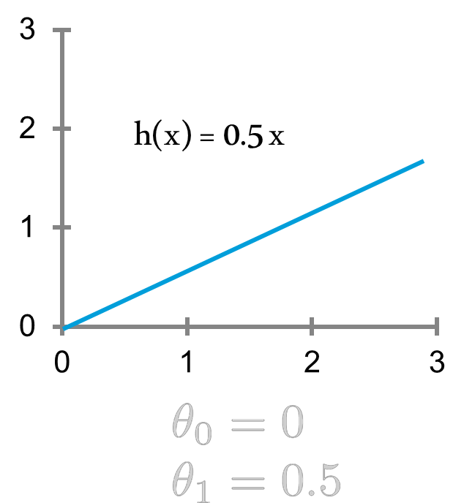
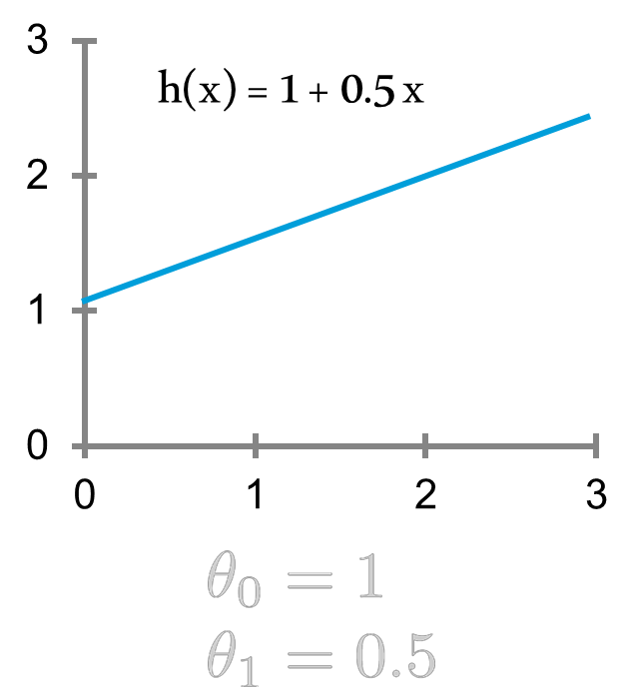
Linear Regression with One Variable (1/2)
Notes:
What do the standard coefficients indicate

Slide 11
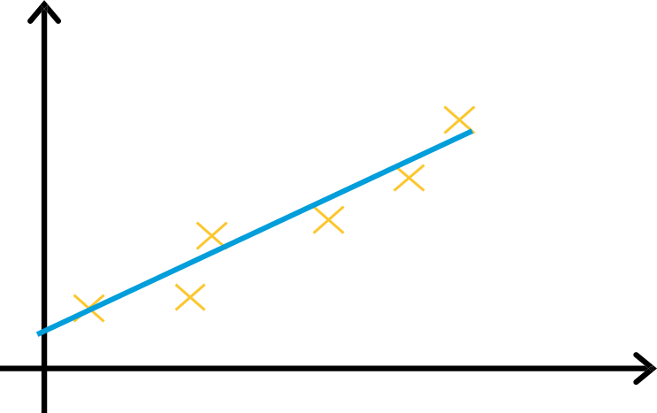

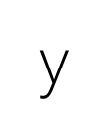
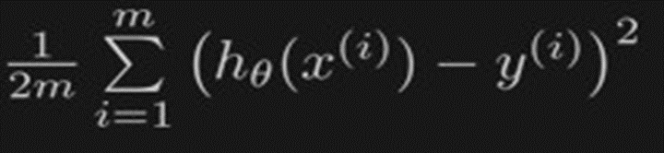
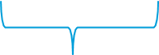
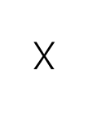

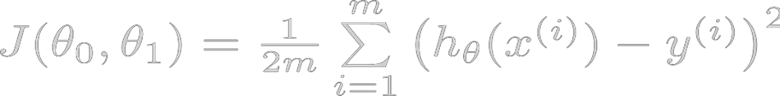




Linear Regression with One Variable (2/2)
Minimize
Idea: Choose so that is close to for our training examples
Notes:
The most common method for fitting a regression line is the method of least-squares. This method calculates the best-fitting line for the observed data by minimizing the sum of the squares of the vertical deviations from each data point to the line (if a point lies on the fitted line exactly, then its vertical deviation is 0). Because the deviations are first squared, then summed, there are no cancellations between positive and negative values.

Slide 12
Linear Regression with Multiple Variables

Slide 13


Multiple Features (Variables)
Size (feet²) | Price ($1000)
2104 | 460
1416 | 232
1534 | 315
852 | 178
… | …

Slide 14
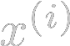

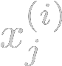
Multiple Features (Variables)
Size (feet²) X₁ | Number of Bedrooms X₂ | Number of floors X₃ | Age of Home (years) X₄ | Price ($1000) Y
2104 | 5 | 1 | 45 | 460
1416 | 3 | 2 | 40 | 232
1534 | 3 | 2 | 30 | 315
852 | 2 | 1 | 36 | 178
… | … | … | … | …
Notation:
= number of features 4
= input ( features) of training example
= value of feature in training example
m= 4

Slide 15

Hypothesis
Previously:
Now:
For convenience of notation, define
x₀ x₁ x₂ x₃ x₄
θ₀ θ₁ θ₂ θ₃ θ₄
X =
θ =
You can be creative in the choice of features:
Polynomials: age, age², age³
Indicator variables: 1 if age>60 and 0 otherwise, etc.
x_{n} θ_{n}
h_{θ}(x) = θ₀x₀ + θ₁ x₁ + θ₂ x₂ + θ₃ x₃+ θ₄ x₄
Multivariate linear regression = θ^{T} x
Notes:
Talk about categorical x’s. For example, if we added a variable called Location which took values City, Town, Village. Then we have to create 2 new variables. One called City which will be 1 if Location has a value of City and 0 otherwise. One called Town which will be a 1 if the value is Town and 0 otherwise.
Also important that 2 highly correlated variables cannot be entered together in the model (age, date of birth) as they will skew modelling results. Only 1 should be chosen.

Slide 16
Overfitting
Overfitting is when...
You choose to memorize and not to understand
When you learn too much about the training data but are unable to generalize the idea
When your results on the training set are good, but on the test set, poor
One solution (of many)
Use less attributes

Slide 17
Outlier: Influential Points

Slide 18
Influential Points
An influential point changes the estimates substantially when omitted
1,000K
f(x)
0
0
2000
Number of Businessweek clicks
Notes:
These can cause major headaches for machine learning. This is the way the model is supposed to look, with everything near the line.

Slide 19
Influential Points
An influential point changes the estimates substantially when omitted
1,000K
f(x)
0
0
2000
Number of Businessweek clicks
Notes:
These can cause major headaches for machine learning. This is the way the model is supposed to look, with everything near the line.

Slide 20
Influential Points
An influential point changes the estimates substantially when omitted
1,000K
f(x)
0
0
2000
Number of Businessweek clicks
Notes:
And you’ll see those bad points in the residual plot.

Slide 21
Influential Points
An influential point changes the estimates substantially when omitted
1,000K
f(x)
0
0
2000
Number of Businessweek clicks
Notes:
And you’ll see those bad points in the residual plot. Remember the residual plot is a histogram of how far the points are from the model. So you’ll have a bump here where most of the points are, and then you’ll see this one point way off in the distance. The difference between the observed value of the dependent variable (y) and the predicted value (ŷ) is called the residual (e). Each data point has one residual.

Slide 22
Influential Points
An influential point changes the estimates substantially when omitted
1,000K
0
0
2000
Number of Businessweek clicks
Notes:
If you remove that point, then the value of f is totally different.

Slide 23
Influential Points
An influential point changes the estimates substantially when omitted
1,000K
0
0
2000
Number of Businessweek clicks
Notes:
*click*

Slide 24
Outlier: Leverage

Slide 25
Leverage
1,000K
f(x)
0
0
2000
Number of Businessweek clicks
Notes:
Leverage is a different sort of thing. Here’s the intuition. You see this point over here? That point, if you move it around

Slide 26
Leverage
1,000K
f(x)
0
0
2000
Number of Businessweek clicks
Notes:
Leverage is a different sort of thing. Here’s the intuition. You see this point over here? That point, if you move it around, not much is going to happen. Even if you move it around quite a bit.

Slide 27
Leverage
1,000K
f(x)
0
0
2000
Number of Businessweek clicks
Notes:
This point on the other hand, is a different story.

Slide 28
Leverage
1,000K
f(x)
0
0
2000
Number of Businessweek clicks
Notes:
Because this point’s x value is far from the other ones, changes in that point are going to have larger effects on the value of f. Even if I move the two points the same amount, the value of f is going to change more for this point than for the other one. That’s called leverage.

Slide 29
Leverage
If you move xi, then f(xi) moves proportionally. The proportionality constant is called the leverage of point i
Leverage depends on xi but not on yi. It depends on how far away xi is from the mean of the xi’s
Influential points do not necessarily have high leverage.
High leverage points are not necessarily influential.
The leverage of x_{i} measures the _{i}).
1,000K
f(x)
0
0
2000
Number of Businessweek clicks
Notes:
More precisely.
So that point has high leverage. It’s not influential. It wouldn’t stick out like a sore thumb on a residual plot.

Slide 30
Leverage
If you move xi, then f(xi) moves proportionally. The proportionality constant is called the leverage of point i
Leverage depends on xi but not on yi. It depends on how far away xi is from the mean of the xi’s
Influential points do not necessarily have high leverage
High leverage points are not necessarily influential
Notes:
More precisely.

Slide 31
Leverage
Low leverage
Very influential
1,000K
f(x)
High leverage
Not influential
0
0
2000
Number of Businessweek clicks
Notes:
This point is very influential but doesn’t have high leverage. If you removed that point, the regression would change. But it’s leverage is low because if you moved it a little bit the line wouldn’t change much. This other point has high leverage but it’s not influential because if you removed it nothing would change.

Slide 32
Investigating Outliers
Is the data correct?
Is the model complete/correct?
Notes:
So what do you do when you see the point? I usually dig into the data to see whether that point is actually correct. Sometimes you go in and look at the data and find out that actually there’s an extra 0, so instead of writing down 10, they wrote down 100, and then you fix it. Or delete it. Sometimes you can’t fix it. If the data’s right, maybe it’s just that the models’ not right, and you might need a model that takes some factor into account that you didn’t have before. That’s where modeling gets to be more of an art than a science in some ways. You have to figure out how to describe the world in a way that makes sense, and that’s what it is.

Slide 33
Logistic Regression

Slide 34
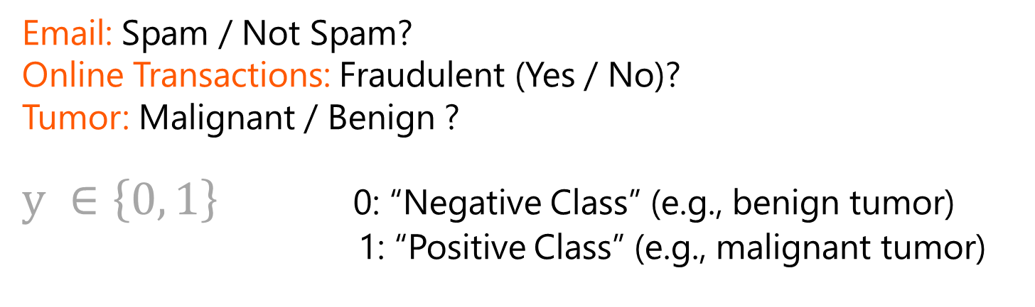
Classification
Email: Spam / Not Spam?
Online Transactions: Fraudulent (Yes / No)?
Tumor: Malignant / Benign ?
$y ∈\left\{0, 1\right\}$0: “Negative Class” (e.g., benign tumor)
1: “Positive Class” (e.g., malignant tumor)

Slide 35
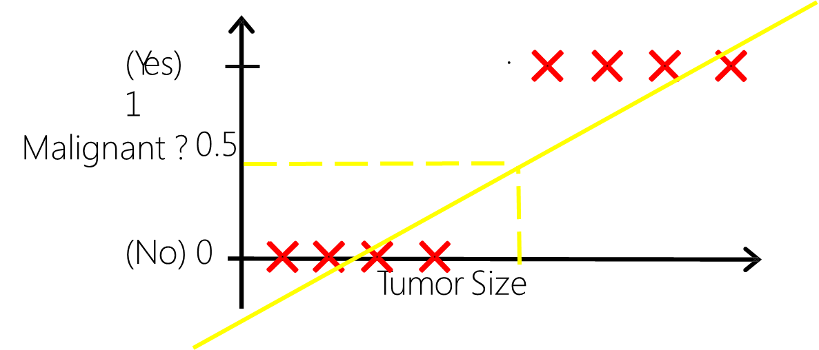



Classification- Case 1
Case 1:
Not Bad
h_{θ}(x) = θ^{T} x
Threshold classifier output
at 0.5:
If , predict “y= 1”
If , predict “y=0”

Slide 36


Classification- Case 2
.
(Yes) 1
0.5
Malignant ?
(No) 0
Tumor Size
Case 2 :
One training value added
h_{θ}(x) = θ^{T} x
Applying linear regression to classification is NOT a good idea.
What just happened?

Slide 37
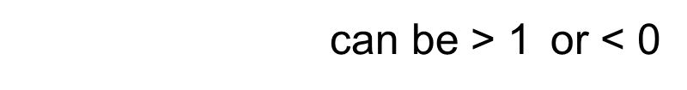

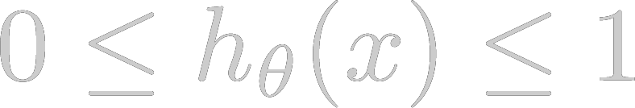
Classification (Continued…)
Classification: y = 0 or 1
Can be > 1 or < 0
Logistic Regression
Classification Algorithm
Y= 0 or 1

Slide 38




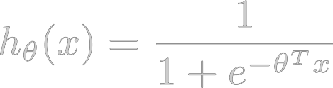
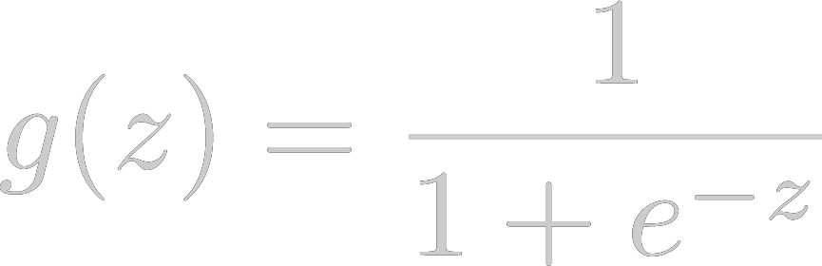
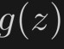
Hypothesis Representation
Logistic Regression Model wants
1
0.5
Sigmoid function
Logistic function
0
Notes:
Outcome
We still predict the probability of the outcome occurring
Differences
Note the multiple regression equation forms part of the logistic regression equation
This part of the equation expands to accommodate additional predictors

Slide 39
Decision Boundary
h(x) = g(θ₀+ θ₁x₁+ θ₂x₂)
-3 1 1
predict “y=1”
if θ^{T} x >= 0
-3 + x1 + x2 >= 0
Plot x1 + x2 = 3
x₂
y=1
x1
Decision Boundary
y=0

Slide 40
Non-Linear Decision Boundary
x₂
h(x) = g(θ₀ +θ₁x₁ + θ₂x₂+ θ₃x₁+ θ₄x₂)
-1 0 0 1 1
y=1
predict “y=1” if θ^{T} x >= 0
-1 +x₁²+ x₂ ² ≥ 0
Plot x₁²+ x₂ ² =1
y=0
x₁
Decision Boundary

Slide 41
Evaluation of Linear & Logistic Regression

Slide 42


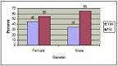

A Recap of Linear & Logistic Regression
Linear Regression
Logistic Regression
y = θ₀x₀ + θ₁ x₁ + θ₂ x₂ + θ₃ x₃+ θ₄ x₄
h(x) = g (θ₀+ θ₁x₁+ θ₂x₂) where
Focus on predicting the values of a continuous outcome based on the values of the independent predictors
Y= continuous dependent/target variable
Ꝋ0= y-intercept
x1 to xk represent the k independent variables (IV)
Ꝋ1 to Ꝋk = coefficients indicating the degree of association between each IV and the DV
Focus on relative probability (odds) of obtaining a given result category
The natural logarithm of the odds is linear across most of its range
h(x)= probability of an event
Ꝋ0 = intercept
x1 to xk represent the k independent variables
Ꝋ1 to Ꝋk = each independent variable’s association with the outcome (log odds)
(No count data = Poisson regression)
Flag
Categorical variable
(Binominal logistic regression)

Slide 43
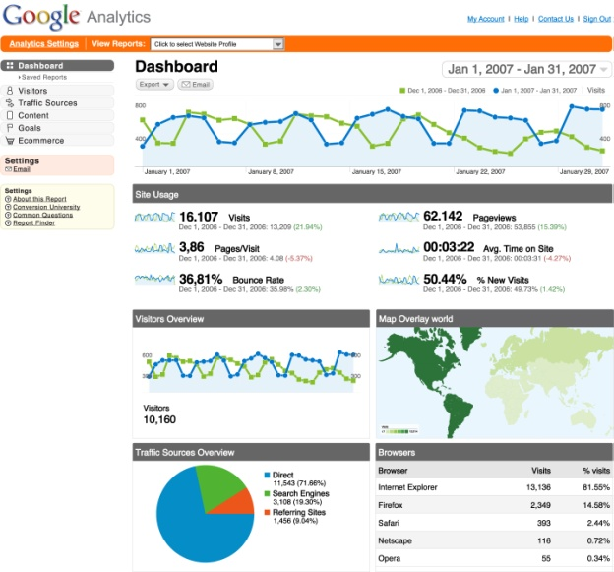
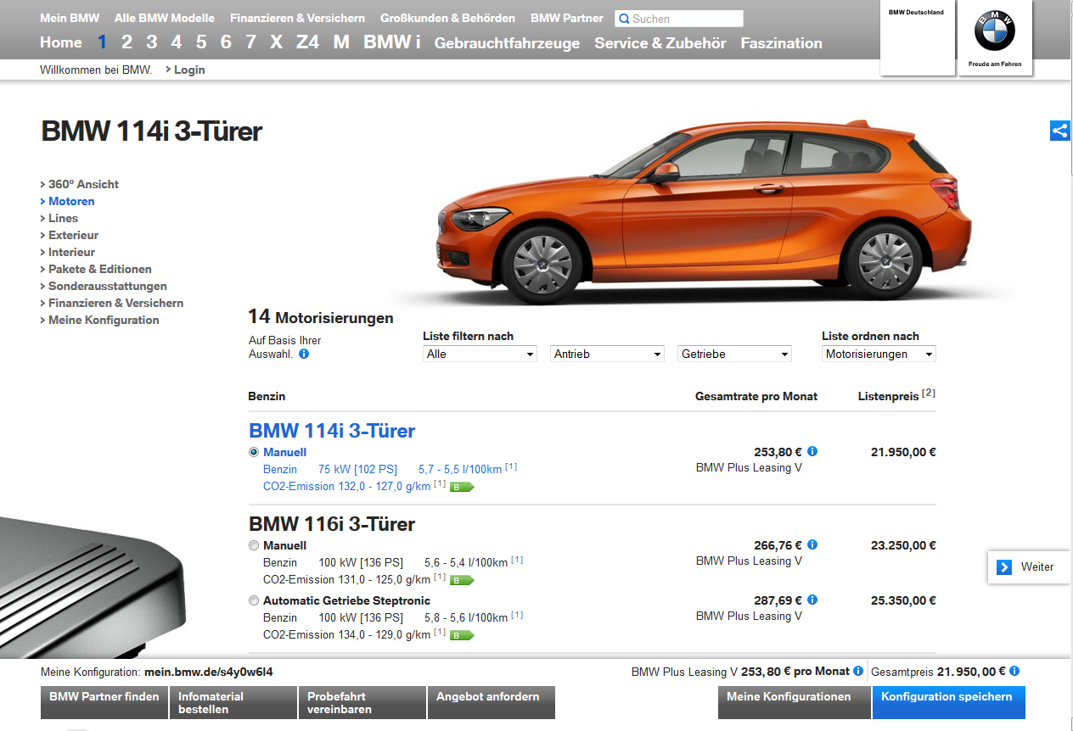
Which Modelling Method would you use? (1/2)
Case 1: Lead Generation Efficiency
A premium automotive brand wants to understand the lead generation efficiency of its website car configurator
They investigate visitor behavior on their website with typical traffic metrics such as
V1: Number of unique visitors per day
V2: Time spent on the website per day
V3: Number of started car configurations per day
V4: Number of finished car configurations per day
Further they use conversion metrics such as
V5: Car configuration details (flag variable) per day
V5: Number of dealer requests per day
V6: Number of brochure downloads per day
Using the available data – how would you measure lead generation efficiency?
Notes:
Solution: Linear Regression, v4 is the dependant variable

Slide 44
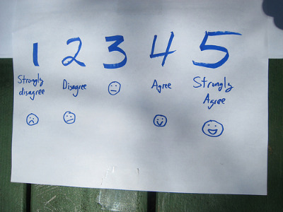

Which Modelling Method would you use? (2/2)
Case 2: Customer Satisfaction
A retail company wants to understand what impacts customer satisfaction during the buying process on their online shop
When entering the website, the customer is asked to fill in a survey for evaluating their website experience
Questions asked concern:
Q1: Usability of the website
Q2: Service guarantee availability
Q3: Number of products usually bought
Q4: Importance of personalization features
Q5: Recommendation of the website to a friend
Q1, Q2 and Q4 are measured on a 5-point Likert scale with 1=Do not agree at all – 5= Totally agree
Q5 can be answered with yes or no
Using the available data – how would you measure customer satisfaction?
Notes:
Solution: Logistic Regression, Q5 is the dependant variable

Slide 45
How to Evaluate the Results of Linear Regression?
Model Evaluation Method | Measure | Result Interpretation
Overall model fit | P-Value for difference between null and the full model determined by the F statistic | If P<0.05 then there is evidence that at least one of the independent variables contributes to the prediction of the outcome.
Goodness of Fit: Coefficient of Determination | R-Square measures the proportion of variation in the target variable that is accounted for (or explained) by the regression model | If the predictions are close to the actual values, we would expect R2 to be close to 1. On the other hand, if the predictions are unrelated to the actual values, then R2=0 or close to 0 . In all cases, R2 lies between 0 and 1
Regression coefficients | P-Value of regression coefficients | If P<0.05 then the variable contributes significantly to the prediction of the outcome variable; The linear regression coefficients show the change in the target variable for one unit change in the independent variables
Notes:
The p-value for each term tests the null hypothesis that the coefficient is equal to zero (no effect). A low p-value (< 0.05) indicates that you can reject the null hypothesis. In other words, a predictor that has a low p-value is likely to be a meaningful addition to your model because changes in the predictor's value are related to changes in the response variable.
Conversely, a larger (insignificant) p-value suggests that changes in the predictor are not associated with changes in the response.

Slide 46
How to Evaluate the Results of Logistic Regression?
Model Evaluation Method | Measure | Result Interpretation
Overall model fit | P-Value for difference between null model -2 Log Likelihood and full model -2 Log Likelihood measured by Chi Squared statistic | If P<0.05 then there is evidence that at least one of the independent variables contributes to the prediction of the outcome.
Strength of association | Pseudo—R-Square measures as an approximate variance in the outcome accounted for by the model | E.g. McFadden: measures variances accounted for - this value tends to be smaller than R-square and values of 0.2 to 0.4 are considered highly satisfactory
Regression coefficients | P-Value of regression coefficients | If P<0.05 then the variable contributes significantly to the prediction of the outcome variable; The logistic regression coefficients show the change (increase when bi>0, decrease when bi<0) in the predicted logged odds of having the characteristic of interest for a one-unit change in the independent variables
Classification evaluation | ROC curve for illustrating the performance of the binary classifier; ROC measures: AUC (Area under curve) Gini coefficient | ROC as a model selection tool: AUC is equal to the probability that a classifier will rank a randomly chosen positive instance higher than a randomly chosen negative one The Gini coefficient measures the inequality among values of a frequency distribution: 0 represents chance performance whilst 1 represents perfect performance
Notes:
Solution: Linear Regression

Slide 47
Evaluate Models
We have many trained models, how to evaluate them and CHOOSE the BEST one?

Slide 48
Model Evaluation
Different Metrics
Different Priorities when evaluating as “good” or “bad”
Unique Goals

Slide 49
Priorities and Goals
Predict the patients with CANCER
Predict the possible BIKE BUYERS
Rare occurrences
Predicted 100 patients as probable cancer cases and only 12 of them have CANCER
Predicted 20 patients as probable cancer cases and 8 of them have CANCER ( missed the 4 real patients)
Cost of False Negative is too high
Not rare occurrences
Predicted 10 customers will buy bike and only 6 of them have bought
Predicted 100 customers will buy bike and only 35 of them have bought
Cost of False Negative is not high
How well a model learns the relationship between features and targets is measured by the Classifier Performance and the ROC Curve

Slide 50
Classifier Performance
Bike-buyer detection , tested 1,207 cases on a trained classification model
Confusion Matrix
True Label | Predicted Label
 | 1 (Predicted Bike Buyer) | 0 (Predicted Non-bike Buyer)
1 (Actual Bike-Buyer) | 506 True Positive (TP) | 112 False Negative (FN)
0 (Actual Non- Bike Buyer) | 169 False Positive (FP) | 420 True Negative (TN)

Slide 51
Accuracy
Percentage of predictions that are correct
Accuracy= (TP+ TN)/ (total test count)
For this example, Accuracy= (506+ 420)/ (506+112+169+420)= 0.76
True Labels | Predicted Label
 | 1 (Predicted Bike Buyer) | 0 (Predicted Non-bike Buyer)
1 (Actual Bike-Buyer) | 506 True Positive (TP) | 112 False Negative (FN)
0 (Actual Non- Bike Buyer) | 169 False Positive (FP) | 420 True Negative (TN)

Slide 52
Performance Metrics
Precision
How many positive predictions are correct ? TP / (TP+FP)
Here, Precision= 506/ (506+169)= 0.74
Recall (Sensitivity)
Percentage of positive labelled instances that were predicted as positive TP / (TP+FN)
Here, recall= 506/ (506+ 112)= 0.81
Specificity
Percentage of negative labelled instances that were predicted as negative TN / (TN + FP)
Here, Specificity= 420/ (420+ 169)= 0.71
 | 1 | 0
1 | 506 TP | 112 FN
0 | 169 FP | 420 TN

Slide 53
Area under ROC Curve
Area under the Receiver Operating Characteristic ROC curve (AUC) is a measure of the model performance
It is a plot of the True Positive Rate (on the y-axis) versus the False Positive Rate (on the x-axis) for every possible classification threshold
Random Model AUC = 0.5
Non-bike-buyer Model 1.0 >= AUC >= 0.5
Perfect Model AUC ~ 1.0
The larger the AUC, the better the model ROC
Curve visualizes all possible classification thresholds but Classification / Confusion Matrix gives you for one threshold
True positive rate Sensitivity
False positive rate (1-specificity)

Slide 54
Area under ROC Curve: Interpretation
Non-bike-buyer AUC is between 0.5 and 1
The higher the area under the curve, the better the model’s performance
If ROC AUC
0.9 to 1.0 = Suspiciously Good
0.8 to 0.9 = Fair
0.6 to 0.8 = Decent Model
0.5 to 0.6 = Worthless Model
< 0.5 = use coin flip instead

Slide 55

You learnt so far…
Linear Regression is a supervised learning technique which predicts real/continuous valued output
Linear Regression can be conducted with multiple variables
Overfitting should be avoided and it happens when we learn too much about the training data without being able to generalize
An influential point can change the estimates significantly when omitted
Influential points do not necessarily have high leverage and vica versa
Logistic Regression is a classification algorithm that can be used to predict a class based outcome
Different metrics are used to evaluate model performance, the confusion matrix, accuracy, precision, recall and specificity are the main metrics used
The area under the ROC curve is a also a measure of model performance: the higher the area under the curve, the better the model performance

